Slide 1
CREDIT EDA CASE STUDY
By SAGAR saywankar

Slide 2
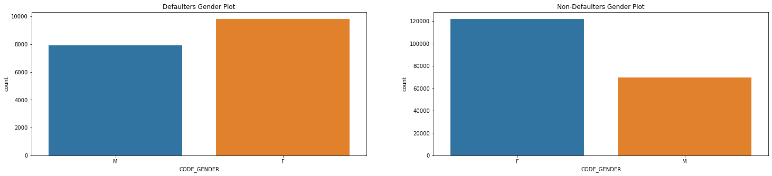
Gender based comparison
(Defaulters & non-Defaulters)target 0
Observations :
There are more female, to opt for credits.
As compared to female candidate, male tend to take less loans.
Given that the female candidates are higher in value to opt for loans, they are more when repaying the loan than male too.
But also the female category tends to go on credit default more than male.
Female values defaulting on loan is less than the ones repaying the loans.
Male values defaulting the loan is slightly more than male values paying the loan.

Slide 3
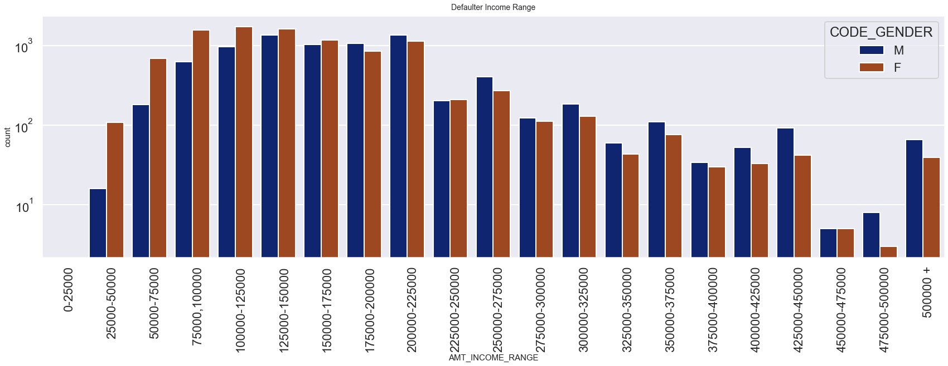
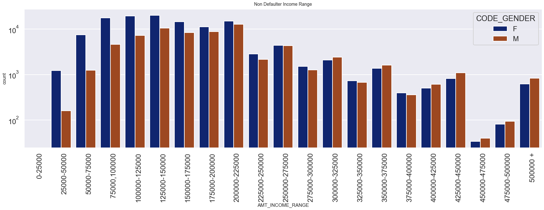
Income Range based on Gender
(Defaulters & non-Defaulters)
Observation:
Male with lower income range tends to default less than female. (50000-225000).
Female with less income range (50000-225000) tends to default more than male but also pays the credit more than males..
Male having more income defaults more.
The hights default ratio of male & female combined is at income range of 125000-150000.
Male having higher salary pays more credit.

Slide 4
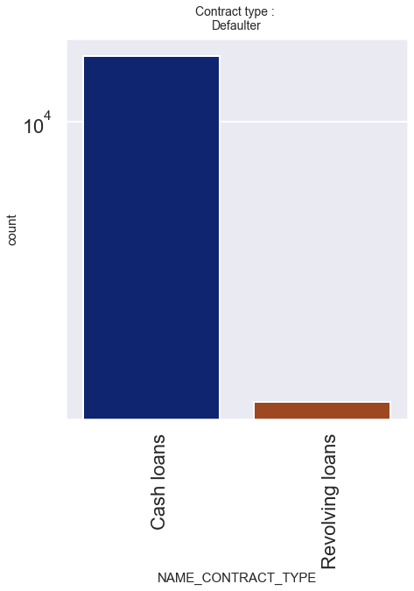
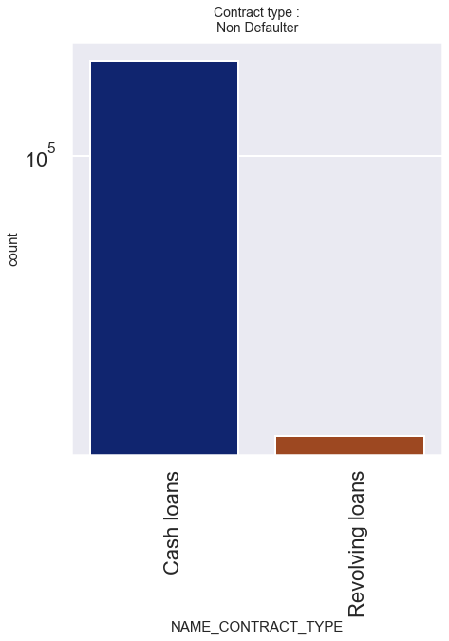
Contract Type
(Defaulter & non Defaulter)
Observations:
There are more number of applicants who chose cash loans as their contact type.
Very few applicants choose Revolving loans as their contract type.
People to default on cash loans are less than who pays the cash loans.
People who default on Revolving loans are almost same with people who pays revolving loans.

Slide 5
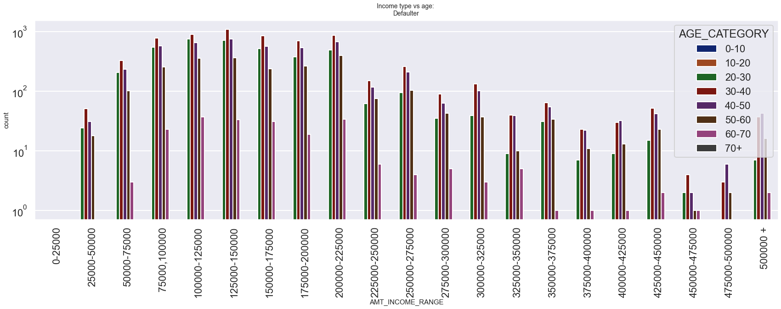
Age vs Income
(Defaulter & non Defaulter)
Observation:
The age group of 30-40 are highest to default in each income range.
People with age between 60-70 defaults less than others.
People with age between 30-40 & income of 125000-150000 are highest to default.
People with age between 60-70 & income more than 350000+ are lowest to default.
People with age between 20-30 & income between 100000-125000 are more likely to default compared to people with age of 40-50 in same income range.

Slide 6
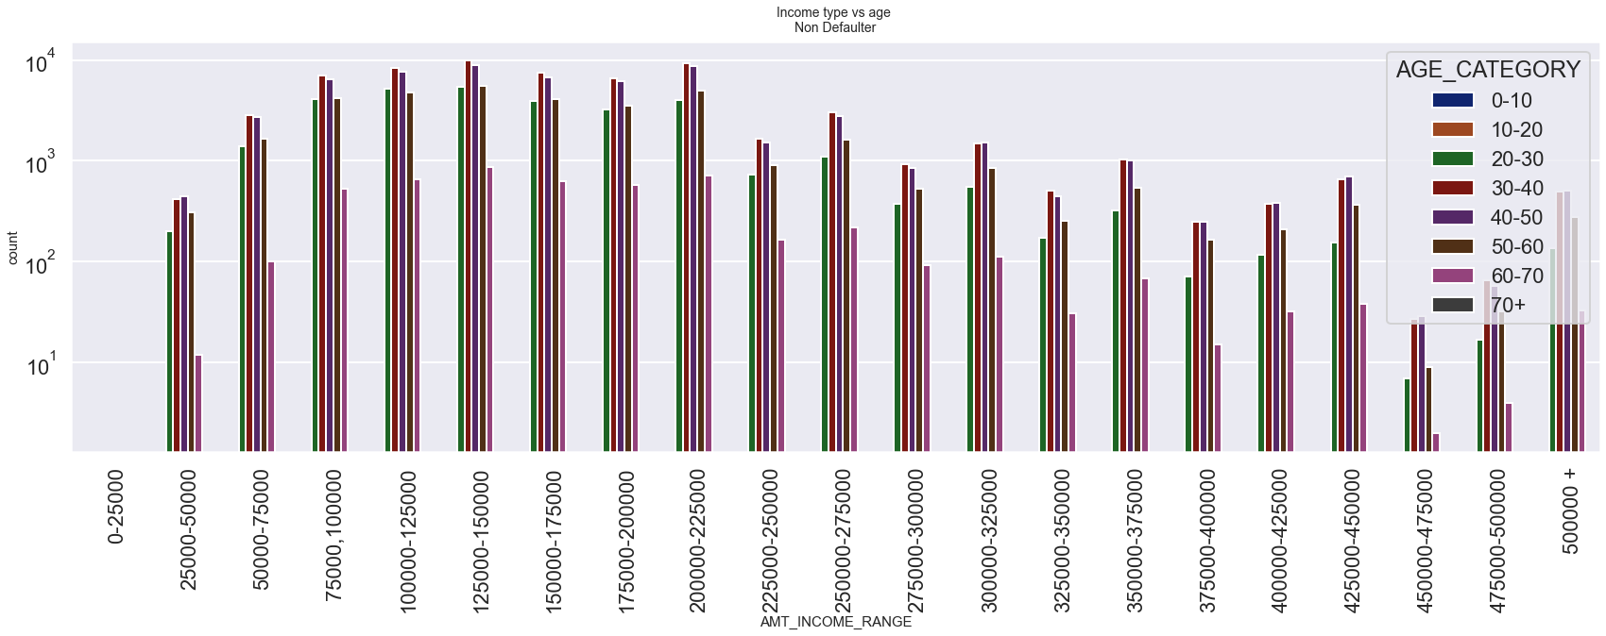
Observation:
people with age range from 30-20 & 40-50 and with lower to average income range pays credit more than other age groups with same income range.
In all the income range, people within age 60-70 are maximum non defaulters if they earn 125000-150000.
Least People within age of 20-30 who earn 450000-475000 tend to not default. Maximum people of same age range and notto default lies between income range of 100000-125000.
More the income range less the people of all age groups to default.

Slide 7
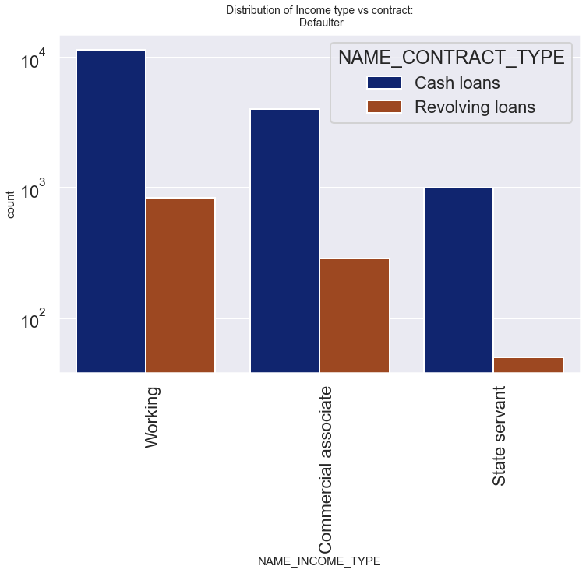
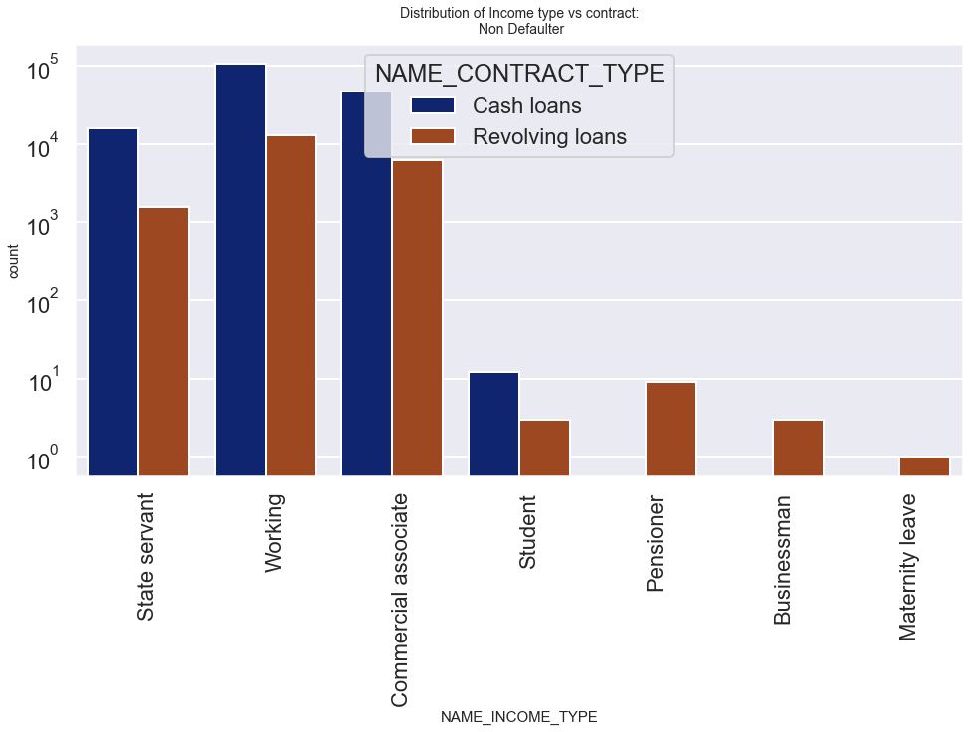
Income type vs Contract type
(Defaulter & non Defaulter)
Observations:
State servant, Working class and commercial associates are highest to avail Cash loan contract as well as revolving Loans.
Students are found lowest compared to avail Cash and Revolving contract loan.
Pensioner and businessman do not opt for cash loan and are only indulged in revolving loans.
women with maternity leave only opt for revolving loan contract.
Working class are highest to default on cash loans as well as revolving loans followed by commercial associates.
State servants are less likely to default on revolving loan, but are also lowest in defaulting on cash loans.
students, pensioners ,businessmen and maternity leave people are less likely to default.

Slide 8
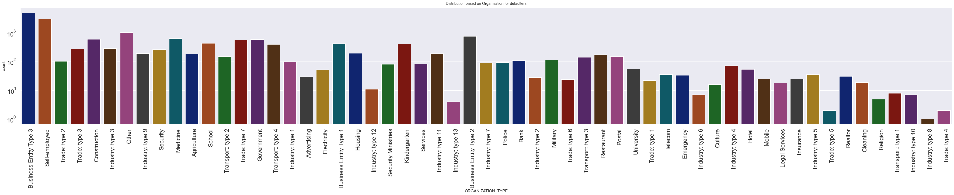
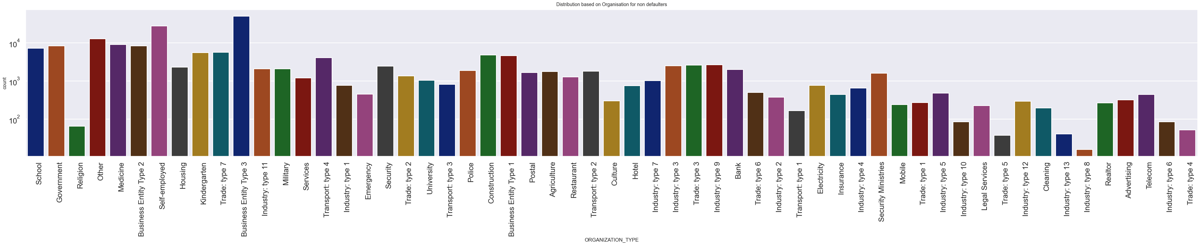
Organization Type
(Defaulter & non Defaulter)

Slide 9
Observations:
Business entity Type 3, Self employed, Other, Medicine and ‘Government are among highest to avail loan.
Industry type 8,type 6, type 10, religion and trade type 5,trade type 4 do not see more interest in availing credit.
business entity type 3 and self employed are highest to default.
industry type 13 and 8, trade type 5 and 4, religion are lowest to default.

Slide 10
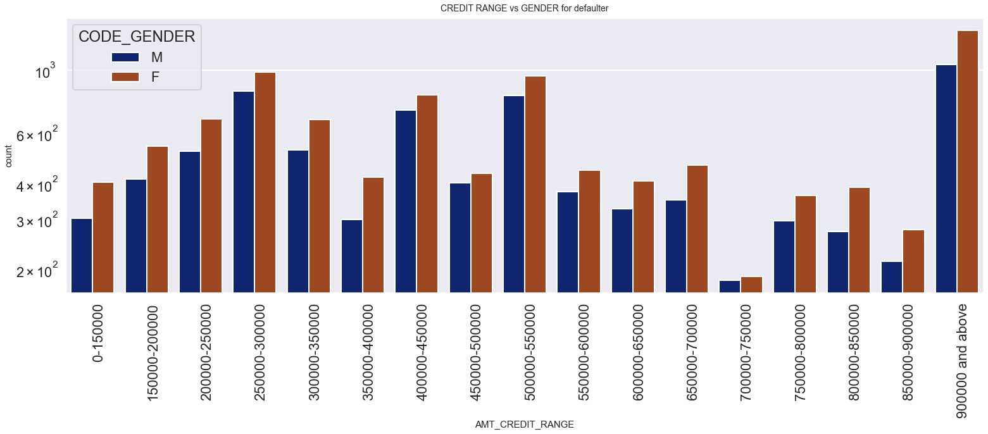
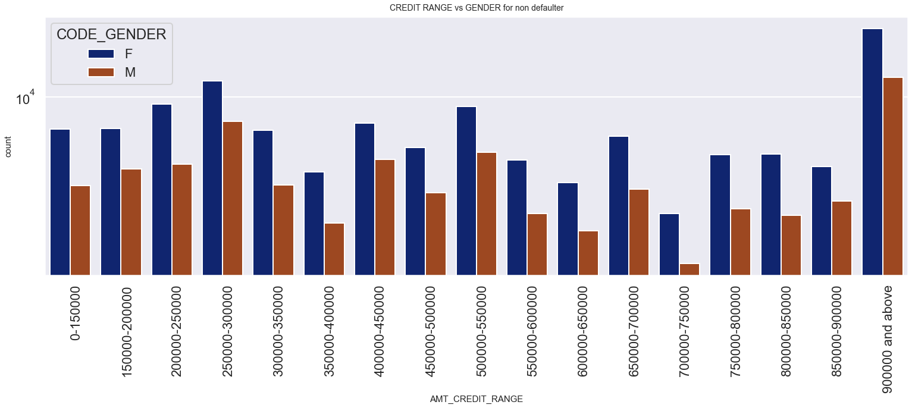
Gender vs Credit Range
(Defaulter & non Defaulter)
Observation:
Both male & female taking credit between700000-750000 tend to default less.
Male & female tends to default more when their income is either too less or too more.
Female candidates tend to default more than male when higher credits are taken.
The least credit range that male and female take is 700000-750000.
Female candidates are more likely to take credits than male.
Resulting in more female candidates to pay credits than male.

Slide 11
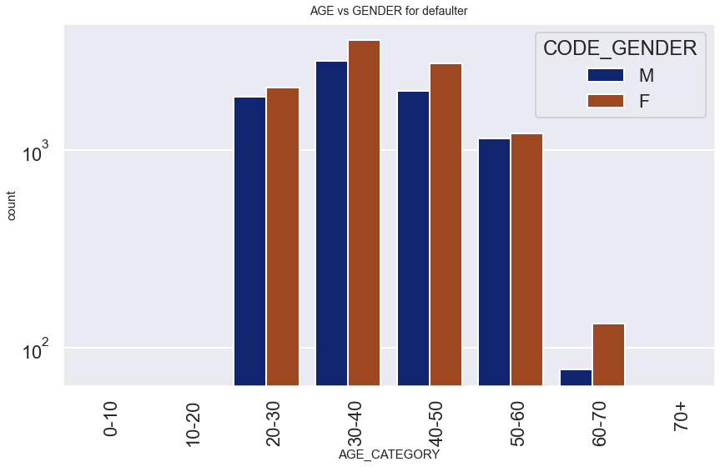
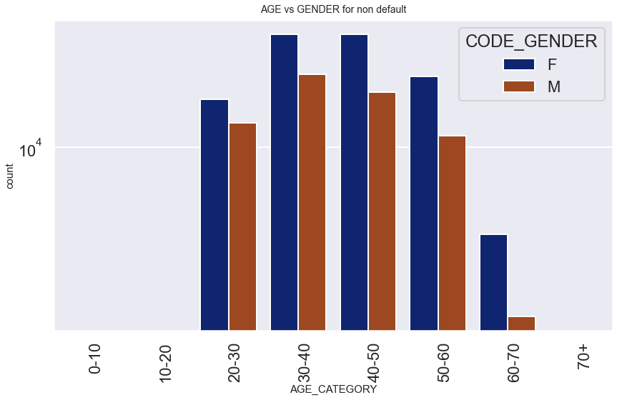
Gender vs Age
(Defaulter & non Defaulter)
Observation :
Male candidates of age 30-40 are more to default.
Female candidates of age 30-40 are more likely to default.
Male & female falling in age category of 60-70 are less likely to default.
Male lying in age of 30-40 also are more non defaulter than any other age group.
Female in age group of 30-50 are most likely to not default.
Male & Female older than 60 are less likely to avail loans.

Slide 12
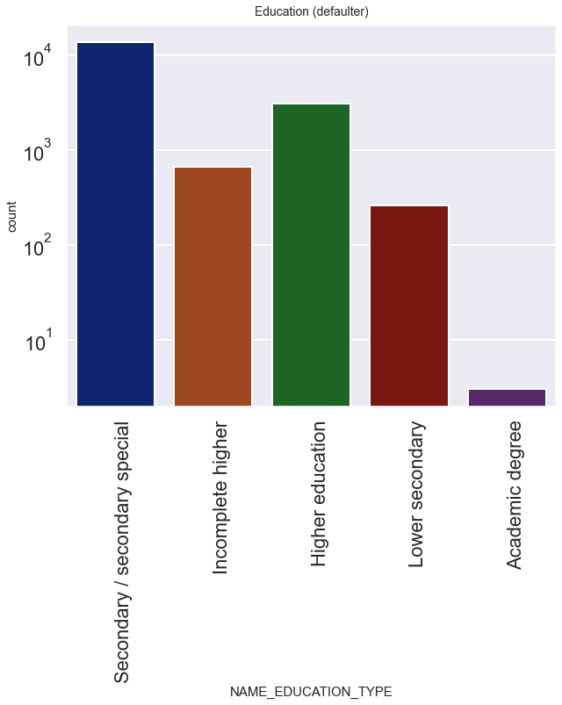
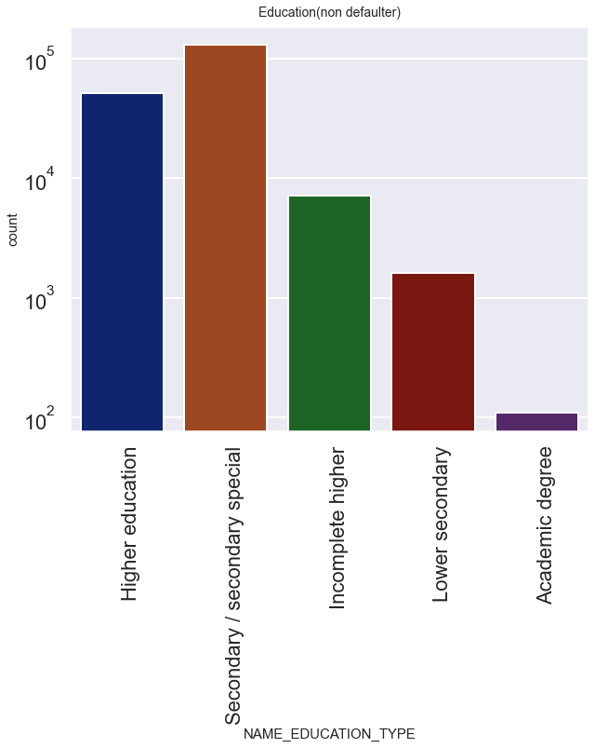
Education Type
(Defaulter & non Defaulter)
Observations:
Secondary/secondary special are highest to repay the loan and highest to default too.
People with higher education, lower secondary education are more to repay the loan than to default.
People with Academic degree are among the lowest to avail the loan and default.
People with incomplete higher who default are close to who are non defaulter of same education type.

Slide 13
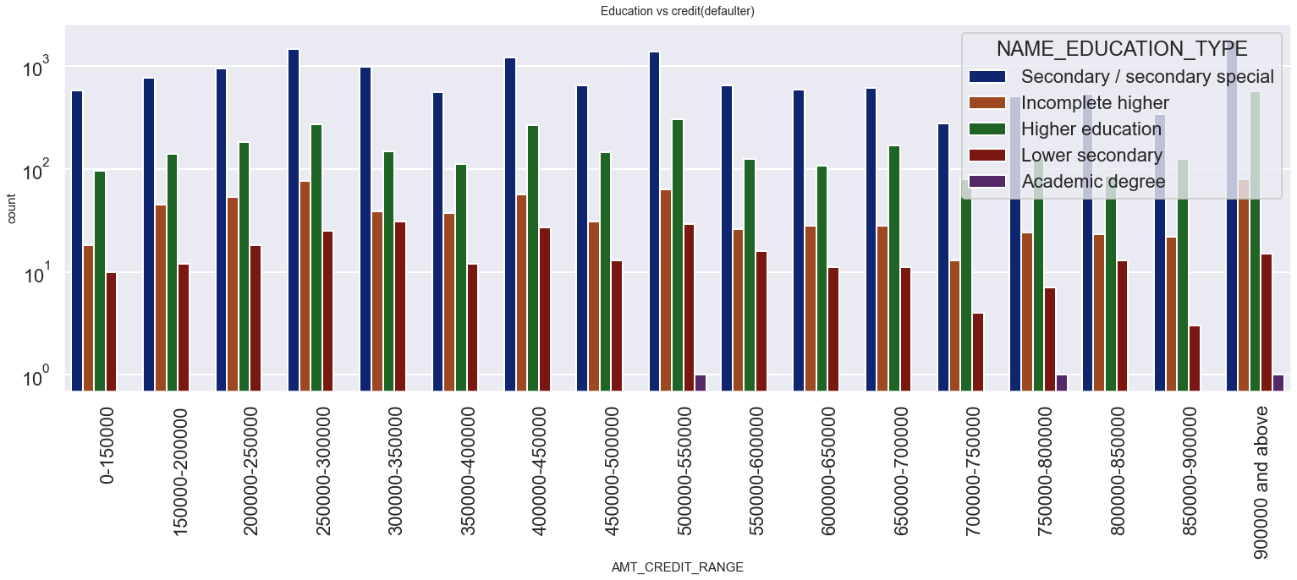
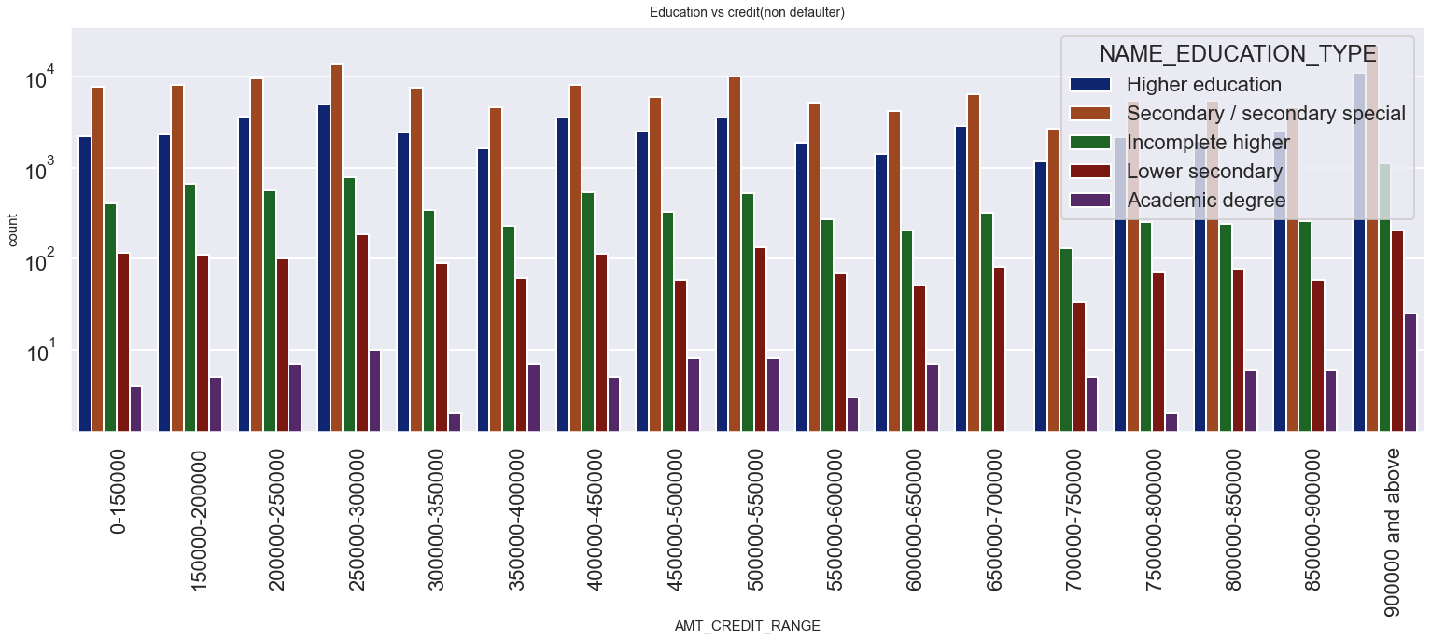
Education Type vs Credit Range
(Defaulter & non Defaulter)

Slide 14
Observations:
  People with secondary education are highest to avail credit in all the ranges.
  People with academic degree are the least to avail the credit in all the ranges.
  People with secondary education are more likely to default in all the ranges.
  People with academic degree have only defaulted at the credit range of 500000-550000,750000-800000,900000+.
  Academic degree people are less likely to default.

Slide 15
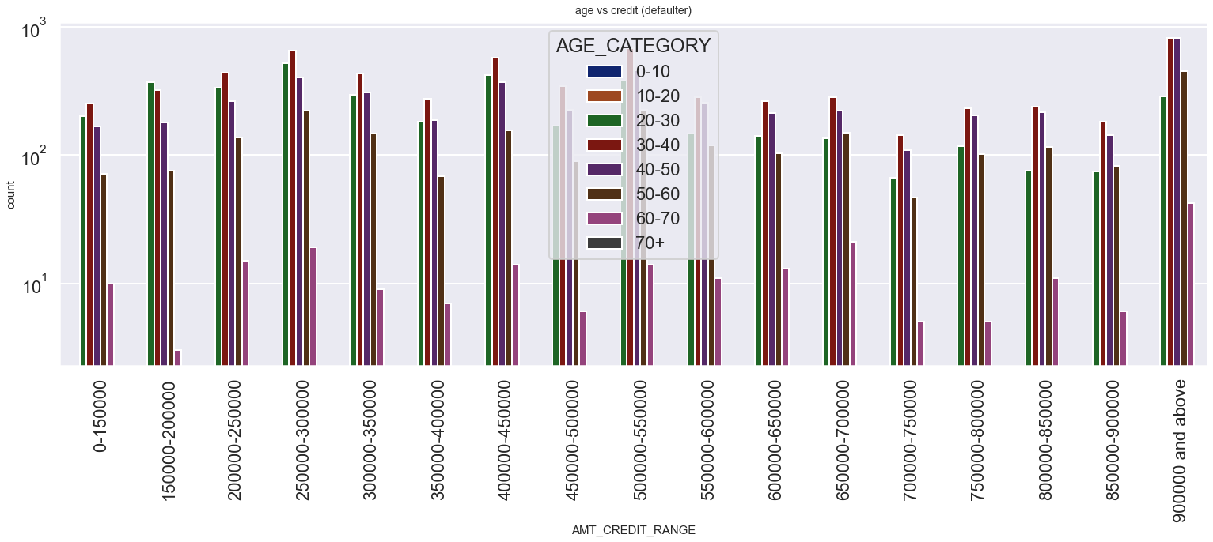
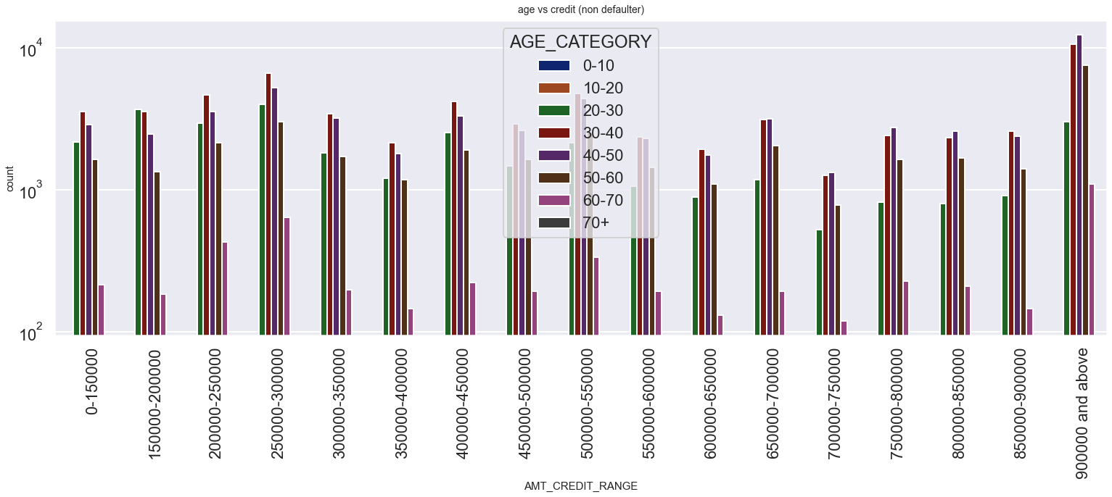
Age vs Credit Range
(Defaulter & non Defaulter)

Slide 16
Observations:
People with :-
age group of 30-40 are more to avail lowest credit range of 0-150000.
age group of 30-40 and 40-50 are more likely to avail more higher credits.
age group of 20-30 tends to avails the maximum credit at range of 250000-300000.
age group of 60-70 are less to get loan but does not default.
age group of 70+ does not avail credit and hence does not default as well.

Slide 17
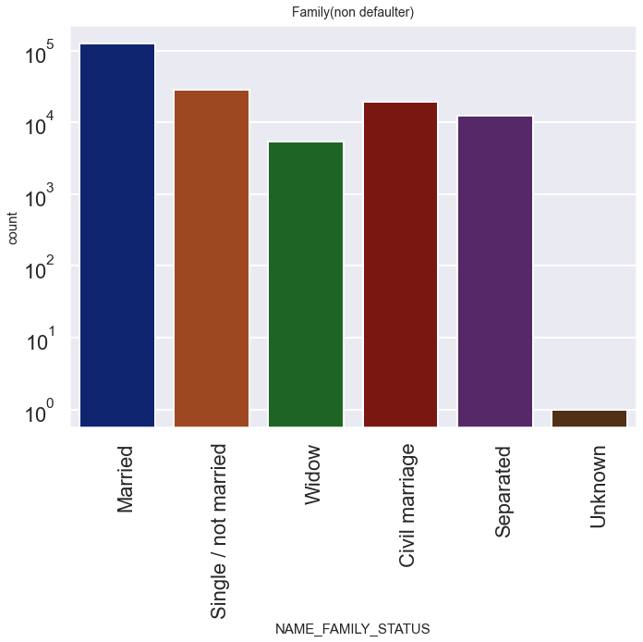
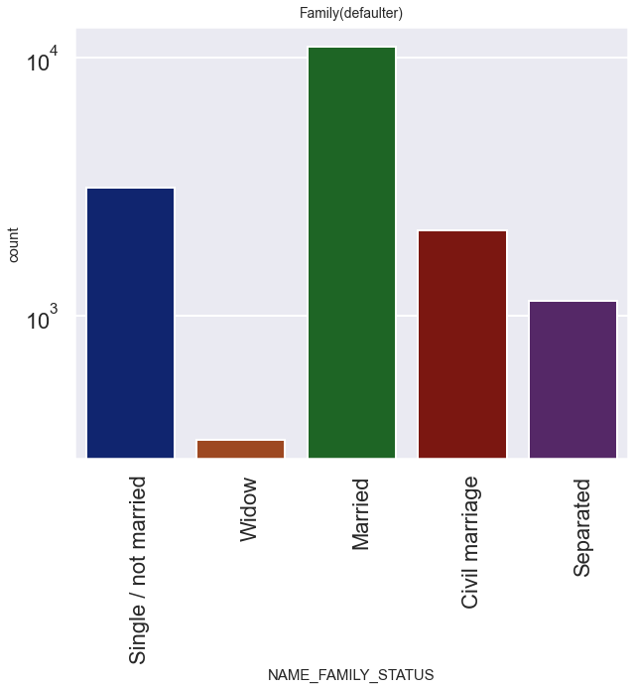
Family Status
(Defaulter & non Defaulter)
Observations:
Married people are more to pay loans and also to default.
Family type 'others' are less to avail loans.
Widow are less likely to default on loans.

Slide 18
Bivariate analysis for numerical variables

Slide 19
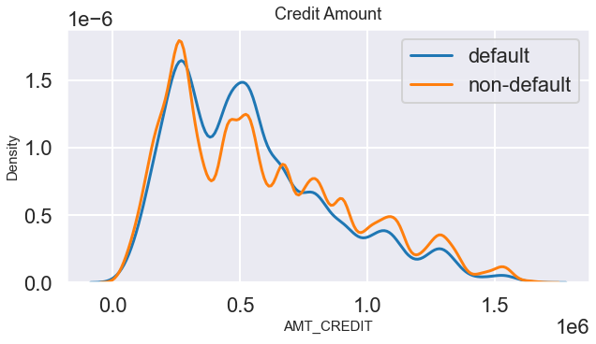
Credit amount
observation:
We can observe that most of the people who take higher amount of credit or loan tends to be defaulters.
Higher the credit amount, higher chance to go default.
Lower the credit taken lower are chances to go default on the loan.

Slide 20
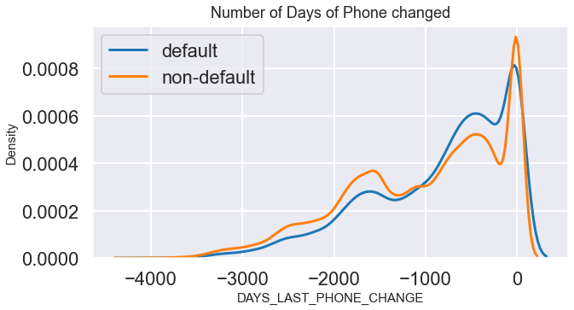
Days last phone changed
observation:
Here we can observe that person who tends to default on a loan may change his phone.
Same pattern also is shown for non defaulters, people who recently changed their phone number may or may not default on the credit.

Slide 21
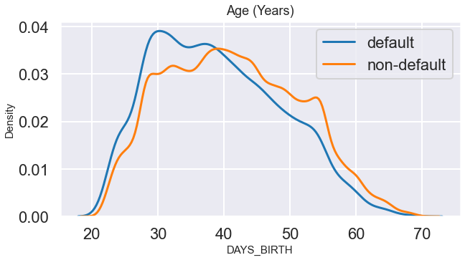
Days birth(in years)
Observation:
We can see that maximum of certain group of people mostly of age 28-39 are non defaulters as well as defaulters too.
So we can conclude that this particular group have max defaulters and also have max non defaulters too.

Slide 22
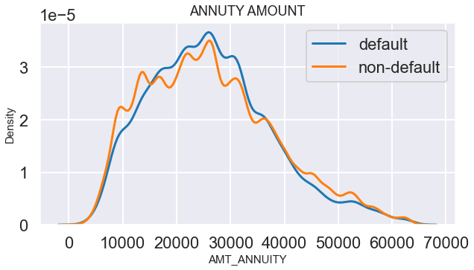
Annuity Amount
Observation:
We can see the defaulters and non defaulters have the similar pattern.
Annuity amount increases between approximate 18000 to 27000.
During these growth we can see growth in defaulters rate as well as non defaulters.

Slide 23
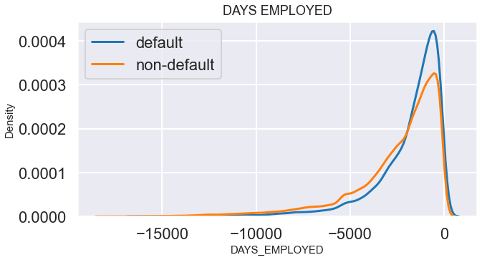
Days employed for.
observation:
people who are employed for less than 5000 days i.e 13 years have growing default rate with growing non default rate.
The graph shows that recently employed people are more likely to default on loan.

Slide 24
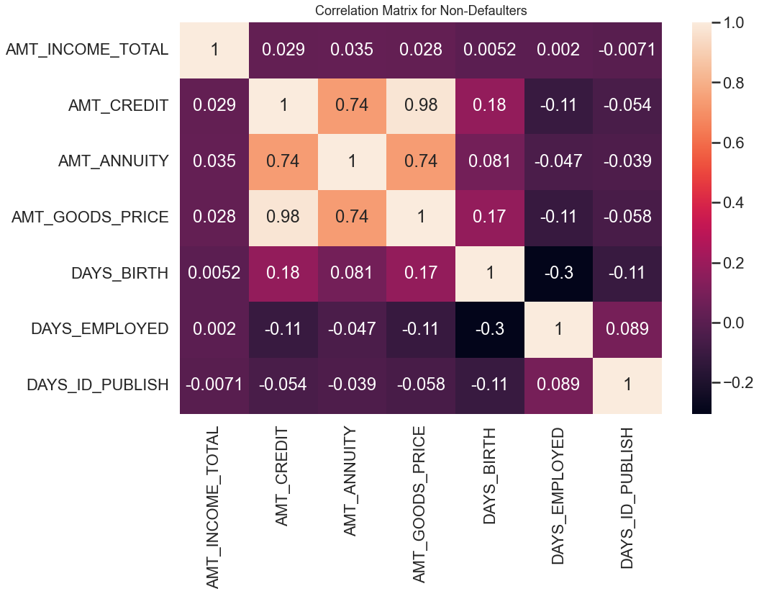
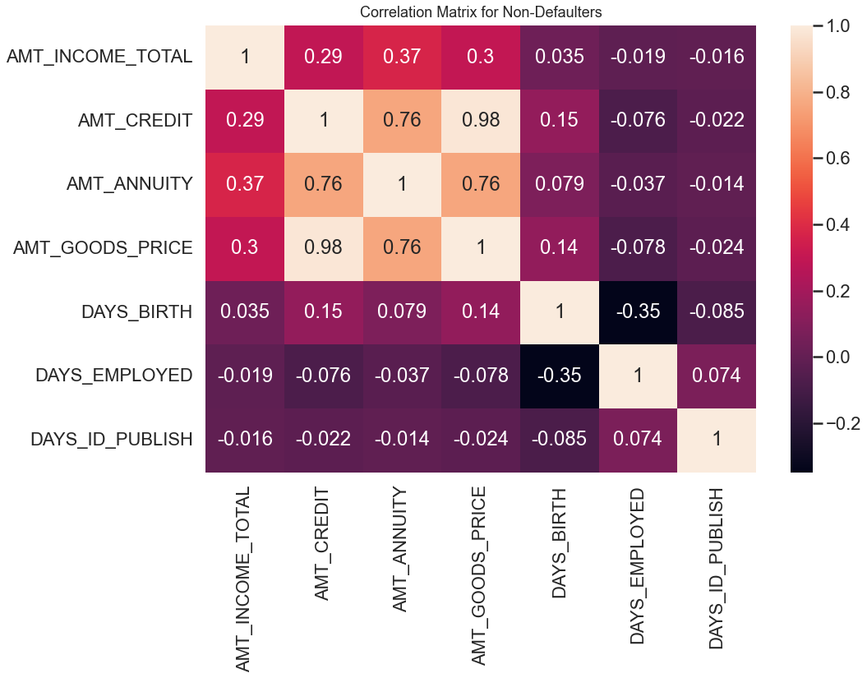
Analyzing correlation for continuous variable (Defaulter and non Defaulter)
Observation :
We can observe that AMT_CREDIT,GOODS_PRICE & AMT_ANNUITY are highly correlated to one another in Defaulters heatmap.
AMT_CREDIT,GOODS_PRICE & AMT_ANNUITY are highly correlated to one another in the above heatmap of Non defaulters too.

Slide 25
Univariate and Bivariate analysis on merged datasets.

Slide 26
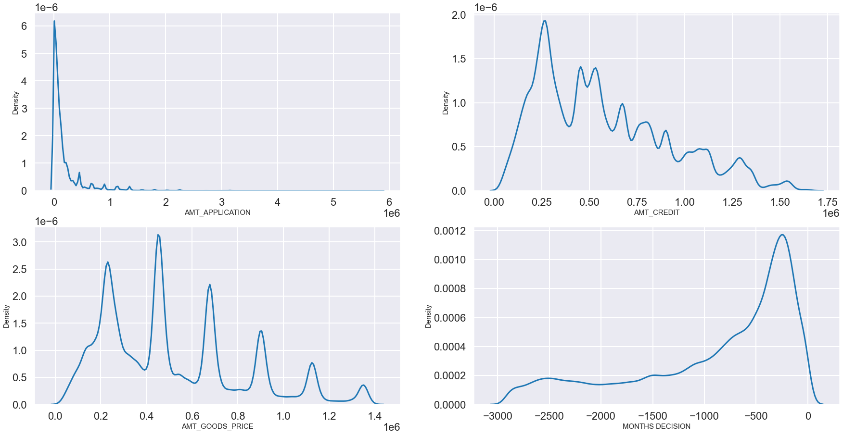
Univariate analysis
AMT_APPLICATION, AMT_CREDIT, AMT_GOODS_PRICE, DAYS_DECISION
Observations
We can see that AMT_GOODS_PRICE & AMT_CREDIT shows strong similar pattern, which means that credit amount was extensively used to buy goods.
Time taken to process the loan amount varies between approximate of 2 months to 30 months.

Slide 27
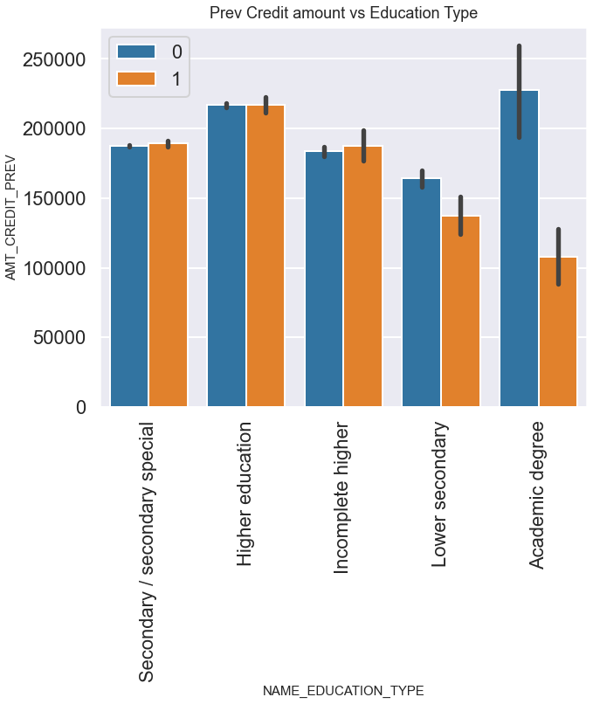
Bivariate analysis
observations:
Here we can observe that people with academic degree are more likely to pay the credit and less likely to default on the credit.
People with higher education are more likely to default than others, so bank should focus less on higher education category candidates and more on candidates who have academic degree.
women tend to use more credit and hence they are more likely to default as well as more likely to not default.

Slide 28
Summery
Large number of applicants are women, Based on their education type and their income range and the credit amount they can pay the loan can be credited to them.
Male population is slightly lower to avail loan but same criteria can be applied to male to avoid defaulting.
Business Entities are highest amongst to avail credits and also to default.
Self employed people can be checked with their education and income type to avail credits to them.

Slide 29
Thank you

